Slide 1
Visual Analytics of Time Series Data
Jeremy Swanson | Summer Student
February 2016

Slide 2

Background
Aim
To explore how data processing and machine learning can be used to visualise trajectory data
2015 VAST Challenge Data
Theme Park: Dino Fun World
Theme park app
Electronic Ticket
Records position
Crime occurred on Sunday
Simulated data
Protects privacy
Limited richness

Slide 3
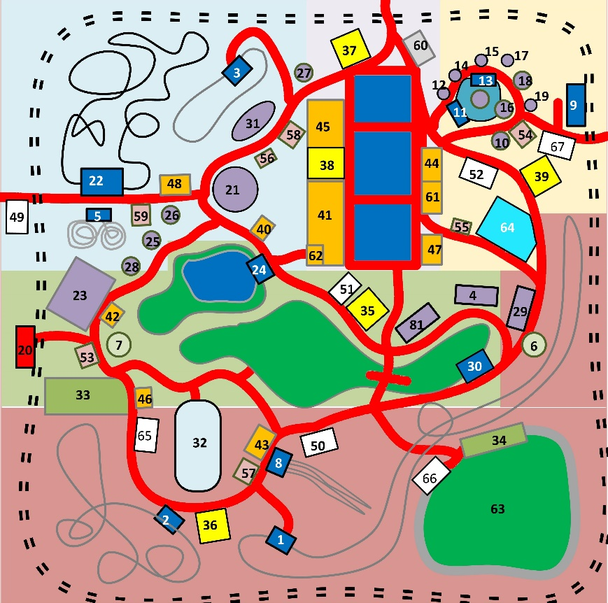
Data Format
Three Days – Friday, Saturday and Sunday
ID, Timestamp, X, Y, check-in type
Average of 10 million of these per day
1 GB of text data
3557 people on Friday, 6411 on Saturday, 7569 on Sunday.
Highly accurate location
Quantisation noise
No additive random noise

Slide 4
Overview
Visualising Trajectories
Analysing Trajectories
Stay Point Detection
Group Detection
Visualising Trends
Investigating Stay Points
Predicting Trends

Slide 5
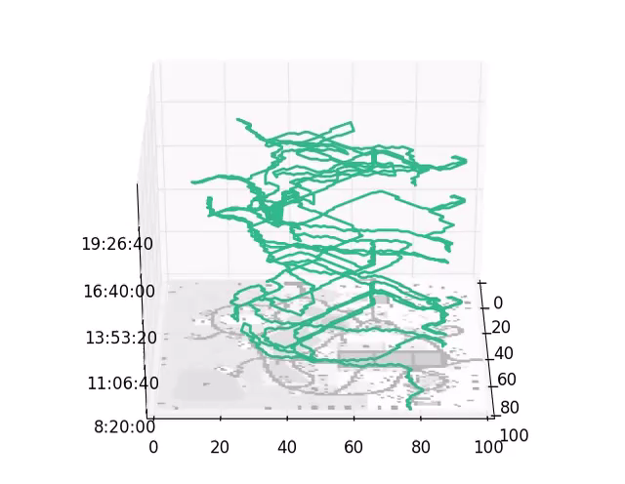
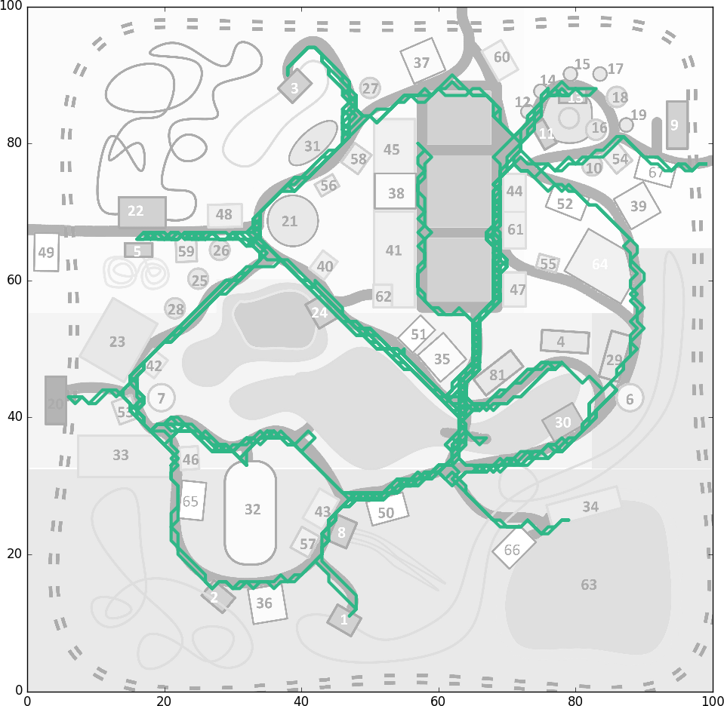
Visualising Trajectories
Space-Time Cube

Slide 6
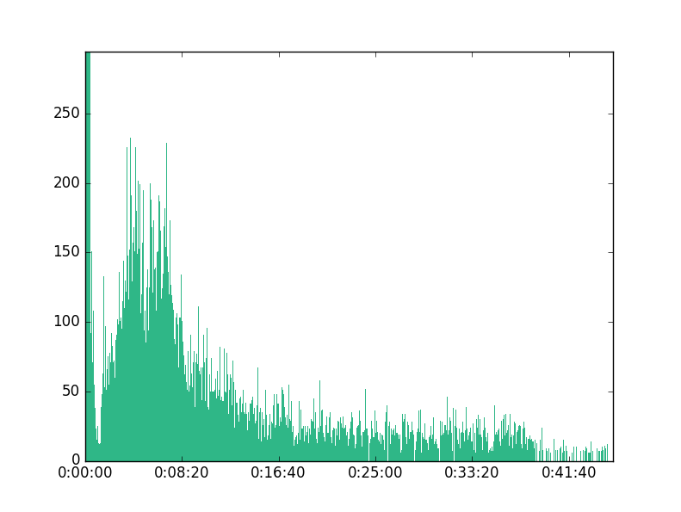
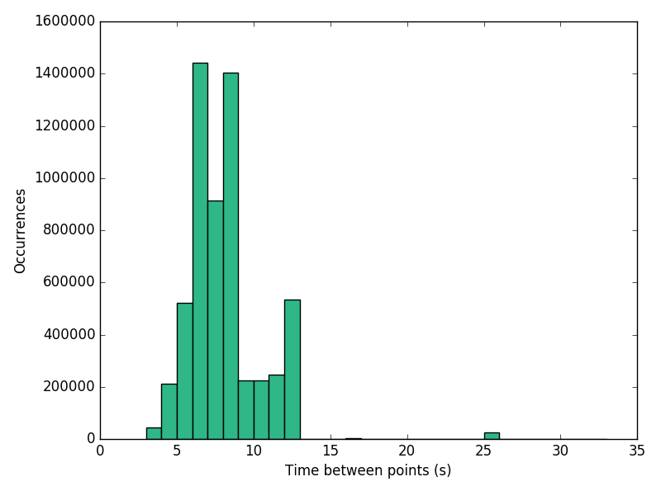
Analysing Trajectories
Stay Point Detection
Determining whether people are stopped
Person staying within a certain radius for a certain time
Extract key points

Slide 7
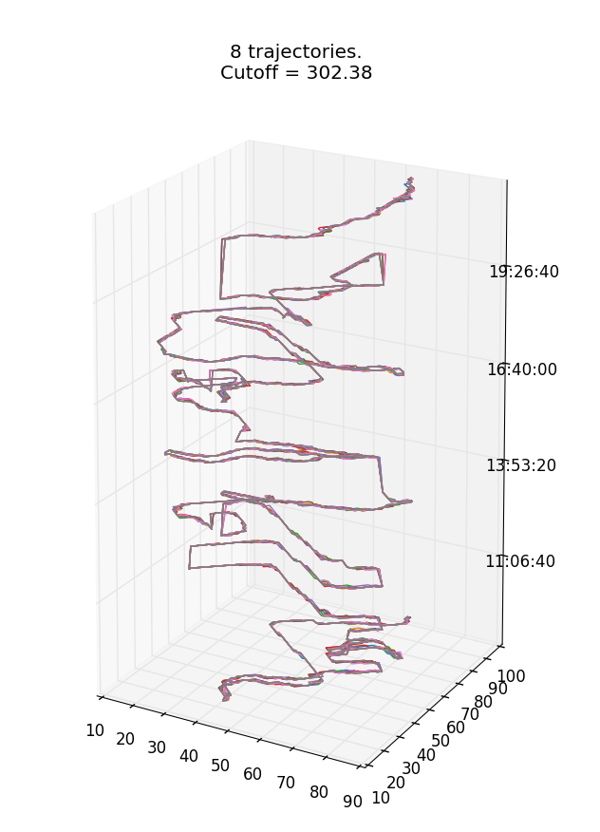
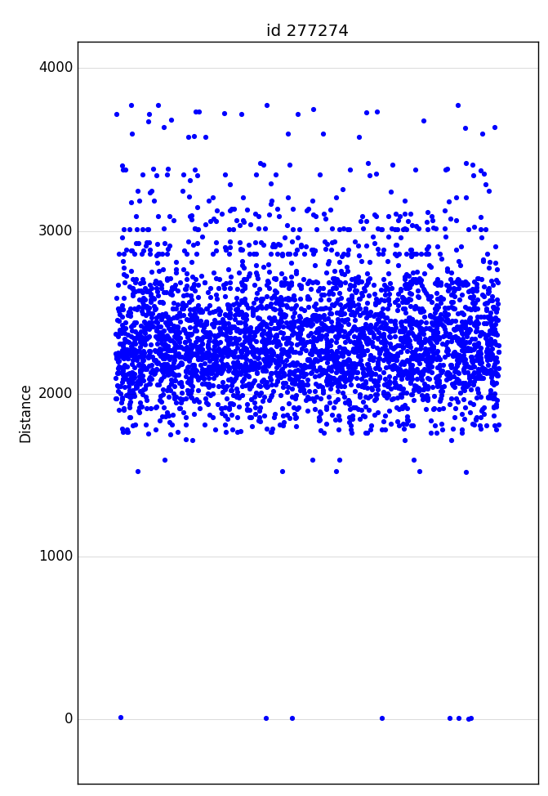
Analysing Trajectories
Group Detection
Grouping metric
Longest Common Subsequence
Levenshtein distance (edit distance)
Dynamic Time Warping
Edit Distance with Real Penalty
Euclidean Distance
Resampling
Compare Element-by-Element
Accounting for different arrival times

Slide 8
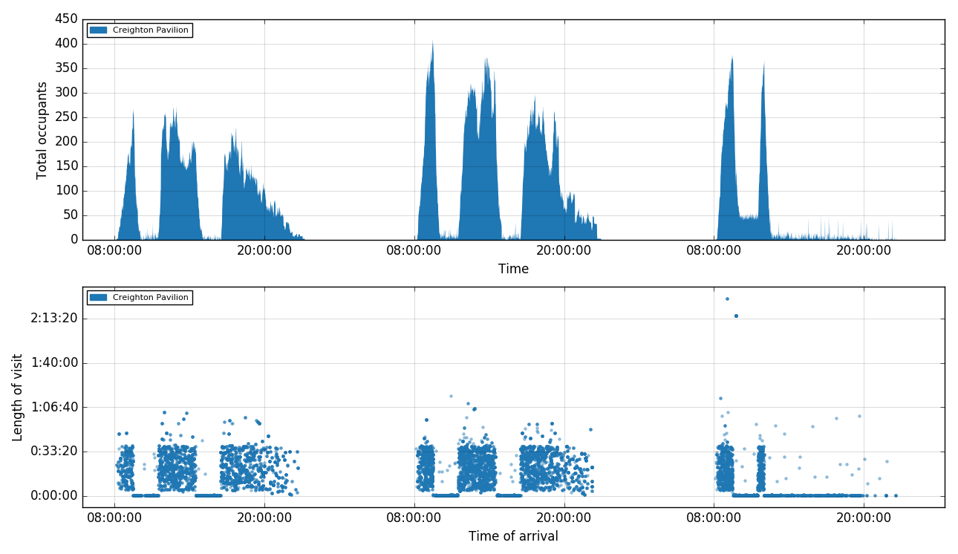
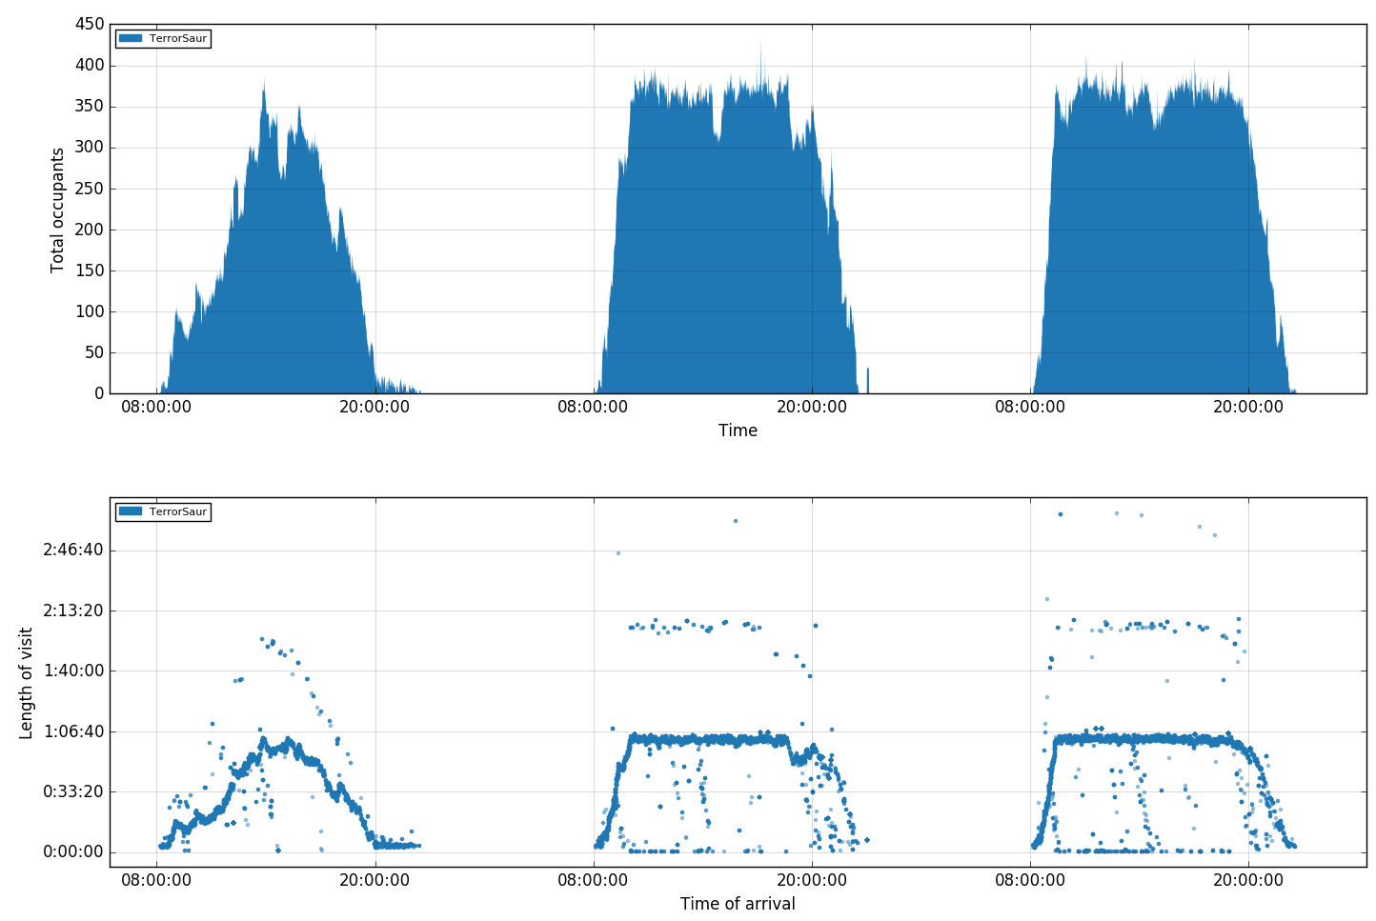
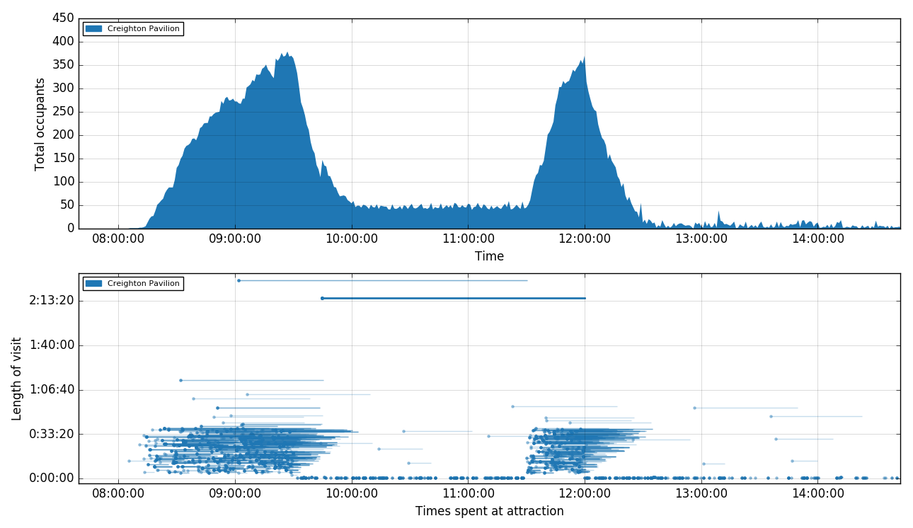
Visualising Trends
Investigating Stay Points

Slide 9
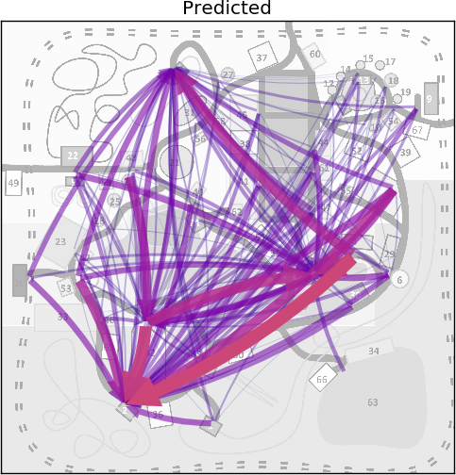
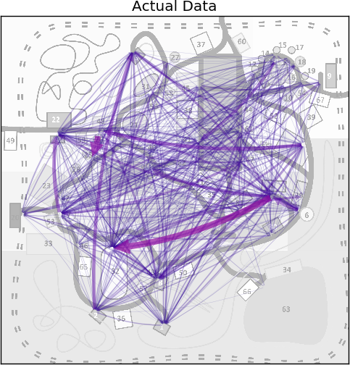
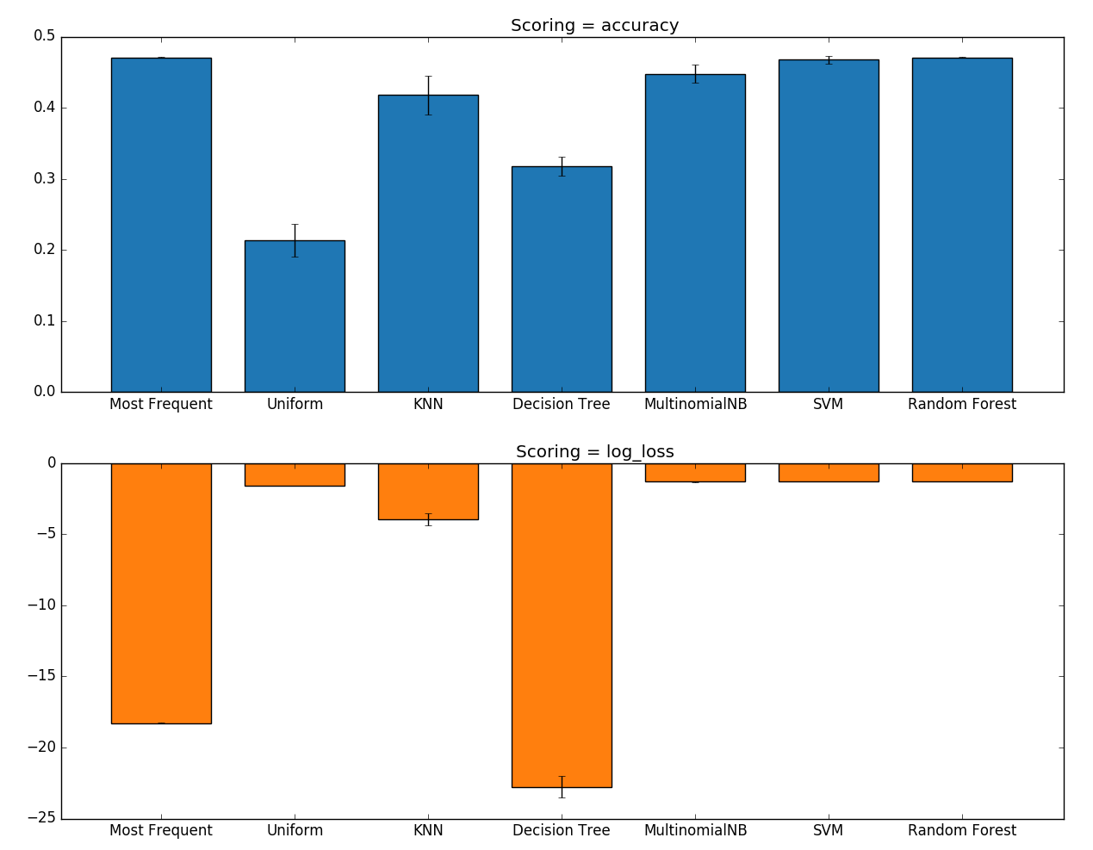
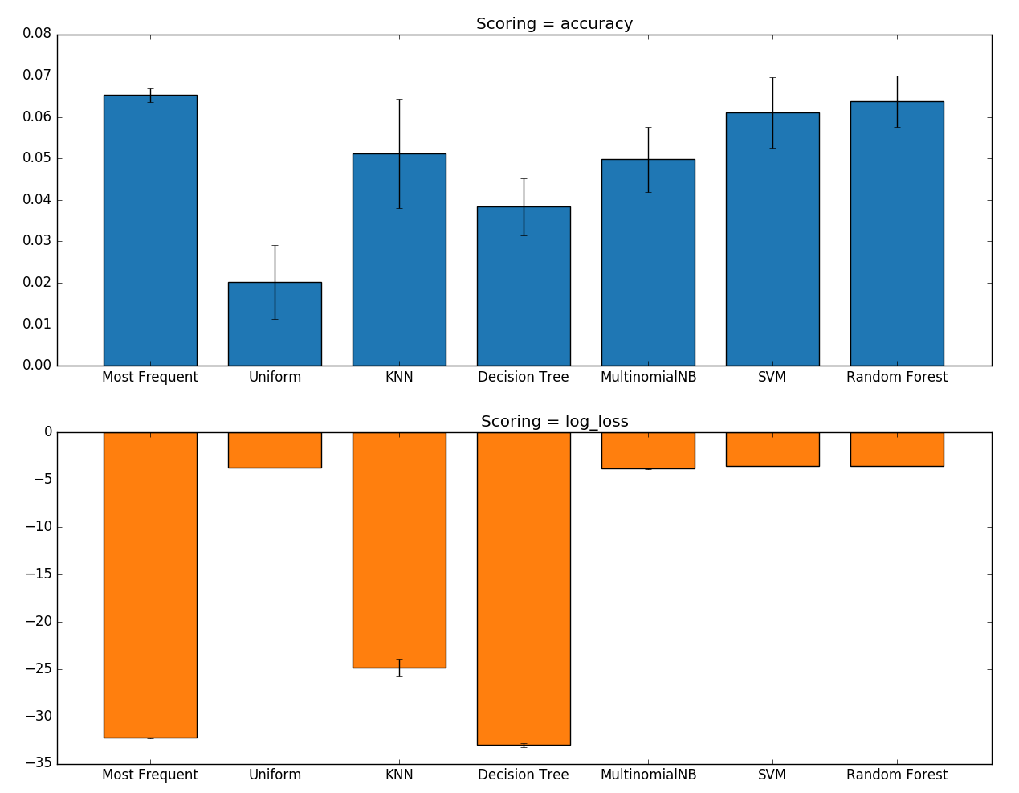
Prediction
Classification problem
Challenges
Many rides
Unpredictability
Limitations of simulation
Predictors
Need to avoid overfitting
Visualising

Slide 10
Thank you
Machine Learning Group
Jeremy Swanson Summer Student
e jeremy.swanson@csiro.au

